Slide 1
Rural Communities in an Urbanizing World
Will they survive? Should Urbanites care?
NARSC Presidential Address
North American Regional Science Conference
San Antonio, TX
November 8, 2018
Partridge.27@osu.edu
Ohio State University and Ph.D. Program, Urban Studies and Regional Science, Gran Sasso Science Institute, L’Aquila, Italy

Slide 2
Introduction
Should we care about rural areas AND should urbanites subsidize them? You can substitute “lagging regions” for “rural.”
  In the past, rural to urban migration meant there were personal connections and less of a rural/urban divide.
Rural areas will play a future role but not all rural places are economically sustainable.
Rural policy needs to consider that government funds are scarce; there are high-valued alternative like healthcare.
Triage is necessary in that sending resources to unsustainable rural places may also harm those who could have been helped because funding is “spread too thin.” (Olfert et al., 2014).
Notes:
Much of this presentation follows:
Partridge, Mark D. and M. Rose Olfert. (2011) “The Winners' Choice: Sustainable Economic Strategies for Successful 21st Century Regions.” Applied Economic Perspectives and Policy. (33): 143-178. doi:10.1093/aepp/ppr006. [Featured Article that Issue].

Slide 3
Introduction
Many people prefer to live in rural areas and will self-sort to live there. We will always have rural.
  A great thing is that your arrival time on the GPS is the same as your departure time in my hometown of Miles City, MT.
Rural areas are the primary source of environment, food, energy, other commodities, natural amenities, water, etc.
Notes:
Goetz, S.J., M.D. Partridge, and H.S. Stephens. (2018) “The Economic Status of Rural America in the President Trump Era and Beyond.” Applied Economic Policy Perspectives. (40): 97-118. https://doi.org/10.1093/aepp/ppx061.

Slide 4

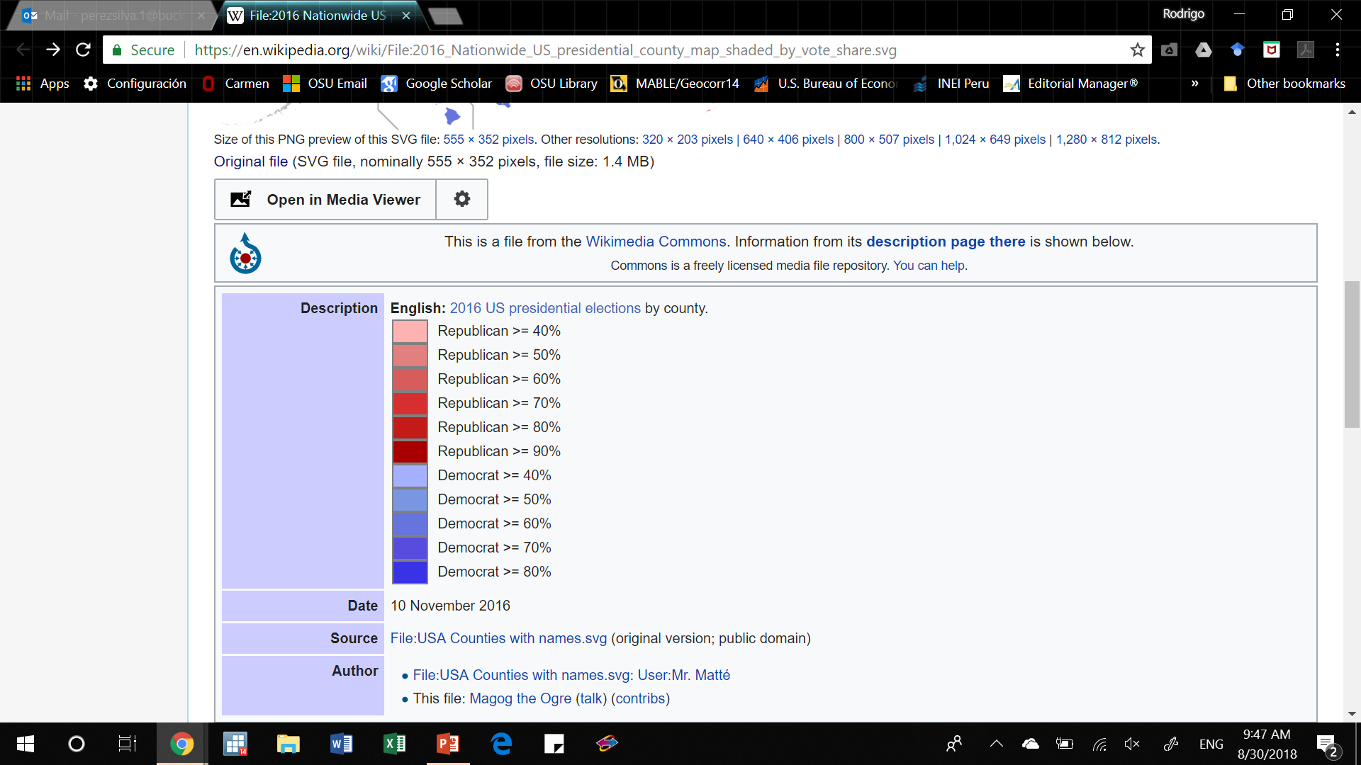
2016 Presidential Vote Share
Red Trump won; Blue Trump lost.
Source: https://en.wikipedia.org/wiki/File:2016_Nationwide_US_presidential_county_map_shaded_by_vote_share.svg

Slide 5
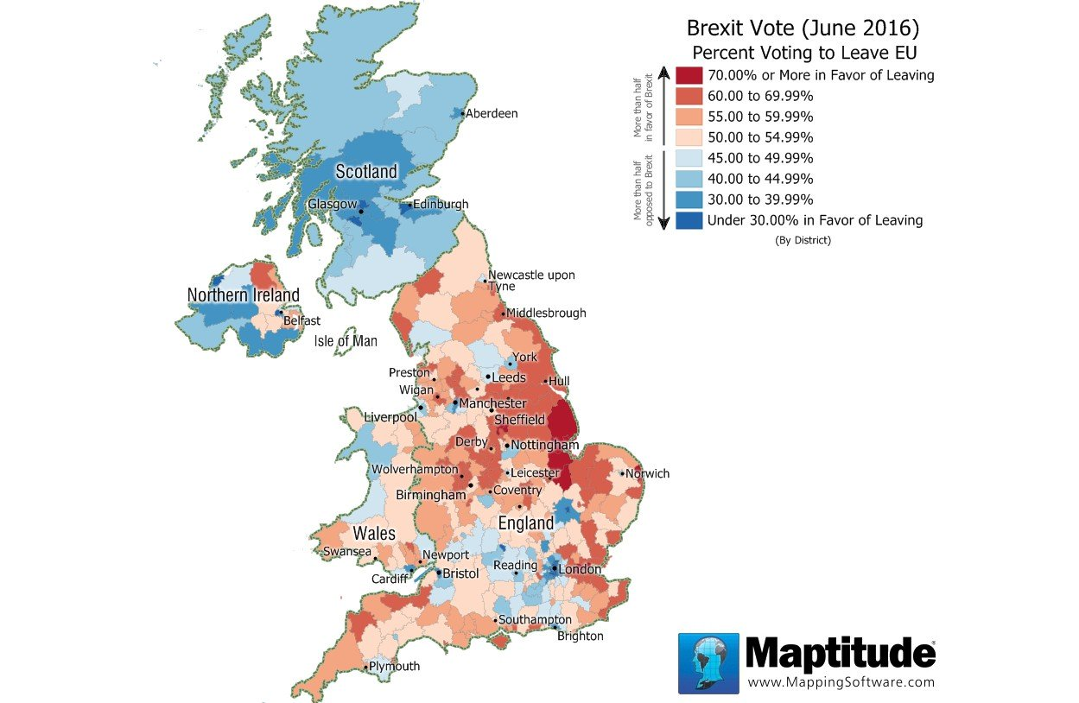
Brexit Vote Share—Red=Leave
Source: https://www.caliper.com/featured-maps/maptitude-brexit-map.html

Slide 6
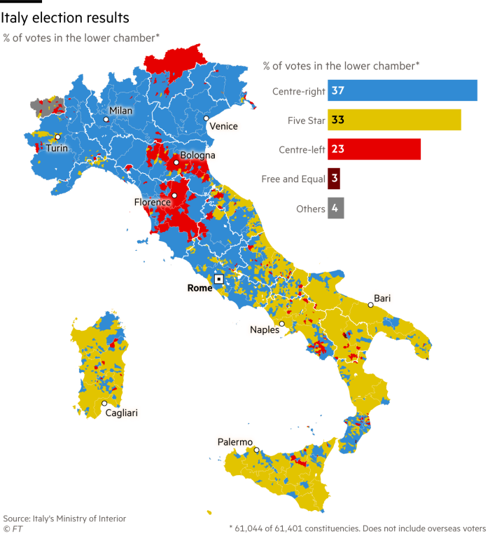
2017 Italian Lower Chamber Results

Slide 7
Rural Depends on Urban for: | Urban Depends on Rural for:
Employment | Labor Force
Private and Public Services | Market for Private and Public Goods and Services
Urban Amenities | Market for Urban Amenities
Market for recreation activities | Outdoor Recreation
Market for agriculture products | Food Safety and Security
Demand for Environmental Stewardship | Natural Environment
Property taxes/land market | Land for Residential and Industrial Expansion
7
Notes:
This table is by way of summarizing some of the relationships. As researchers in rural development, we seem to spend quite a lot of our time convincing rural and urban audiences, and especially the latter that the interdependence is mutual, that a regional approach makes sense. This table can be used to illustrate the interdependence. The shading on here was initially designed to signify demand and supply though I am not sure that is entirely applicable. But I think of the white as the demand side of both product and factor markets and the shaded as supply. So the rural population, at least within commuting distance depends on urban for employment, for private and public services, and for urban amenities. Extending out some distance form the urban centre, the rural population is on the demand side for these goods and services. From the perspective of the urban centre, they depend on the rural labour force for some of their workforce, the rural population forms part of the market for the private and public goods and services provided in the city, as well as the urban amenities.
On the other hand, Urban residents have a demand for recreation in rural areas, for food safety and security, for a maintained environment, and for land for residential, industrial and commercial development beyond their current boundaries if they are to expand in an orderly way. From the rural perspective each of these can be seen as the basis for supplying recreation activities, food, environmental stewardship, and some arrangement for realizing tax revenues or proceeds from the sale of land.
A full understanding of these relationships is necessary in order to elicit the kind of cooperation or joint effort that is required to realize the mutual benefits of this interdependence. Mutual benefits as well as conflicts—both call for cooperation . Ultimately governance of urban and rural areas is involved.

Slide 8
Introduction
More thought is necessary about rural policy—ignore it at urban areas’ peril: economically, socially, environmentally, and politically.
  Rural and peripheral areas were among the strongest regions in Trump’s electoral success (Goetz et al., 2018), which was not favored in urban America.
OECD (2010) does not show a general rapid decline in nonmetropolitan share of population in “rich” economies.
Yet, rural areas face many challenges and many rural areas no longer serve a role that sustains their existence.
Notes:
Source: Organisation for Economic Co-operation and Development, China Development Research Foundation (2010) Trends in Urbanisation and Urban Policies in OECD Countries: What Lessons For China. Available at: www.oecd.org/dataoecd/2/18/45159707.pdf.
Goetz, S.J., M.D. Partridge, and H.S. Stephens. (2018) “The Economic Status of Rural America in the President Trump Era and Beyond.” Applied Economic Policy Perspectives. (40): 97-118. https://doi.org/10.1093/aepp/ppx061.

Slide 9
Outline
In what follows,
I am going to point out areas where regional scientists should call BS to people who are masquerading as regional scientists.
1. I will discuss the background of rural and peripheral economic growth focusing on the USA.
  US is good place to examine these due its spatial heterogeneity.
2. I will show that urban areas do not entirely dominate rural areas in terms of growth, contrary to public perceptions.
  Weigh net spread and backwash effects of urban growth on rural areas.
  Partridge et al (2007) contend spread is the dominant feature in modern regional economies.
3. Discuss policy implications for governance and rural policy.
4. I will then discuss my rural policy recommendations based on nearly three decades of observations.
Notes:
Partridge, Mark D., Ray Bollman, M. Rose Olfert and Alessandro Alasia. “Riding the Wave of Urban Growth in the Countryside: Spread, Backwash, or Stagnation,” Land Economics, 83 (May 2007, 2): 128-152.
Barro and Sala-i-Martin:

Slide 10
Background
What is definition of “rural” going forward?
  Europe gets this: Labor market/(FEA) economic integration/metropolitan areas—not population density, the appearance of the landscape, or cultural attitudes—and definitely not how (say) a New York Times writer defines it.
  What is urban is country specific. I believe 100K in the US.
Despite my somewhat optimistic statements regarding rural conditions, urban areas possess significant agglomeration economies that increase firm productivity and enhance household consumption.
  For example, the internet has been held out for the last quarter century as a potential life saver for rural areas.
    That is unlikely to be true….think Amazon or think how it is so much easier to work from home in major urban areas, reducing household commuting costs. (Netflix effect)

Slide 11
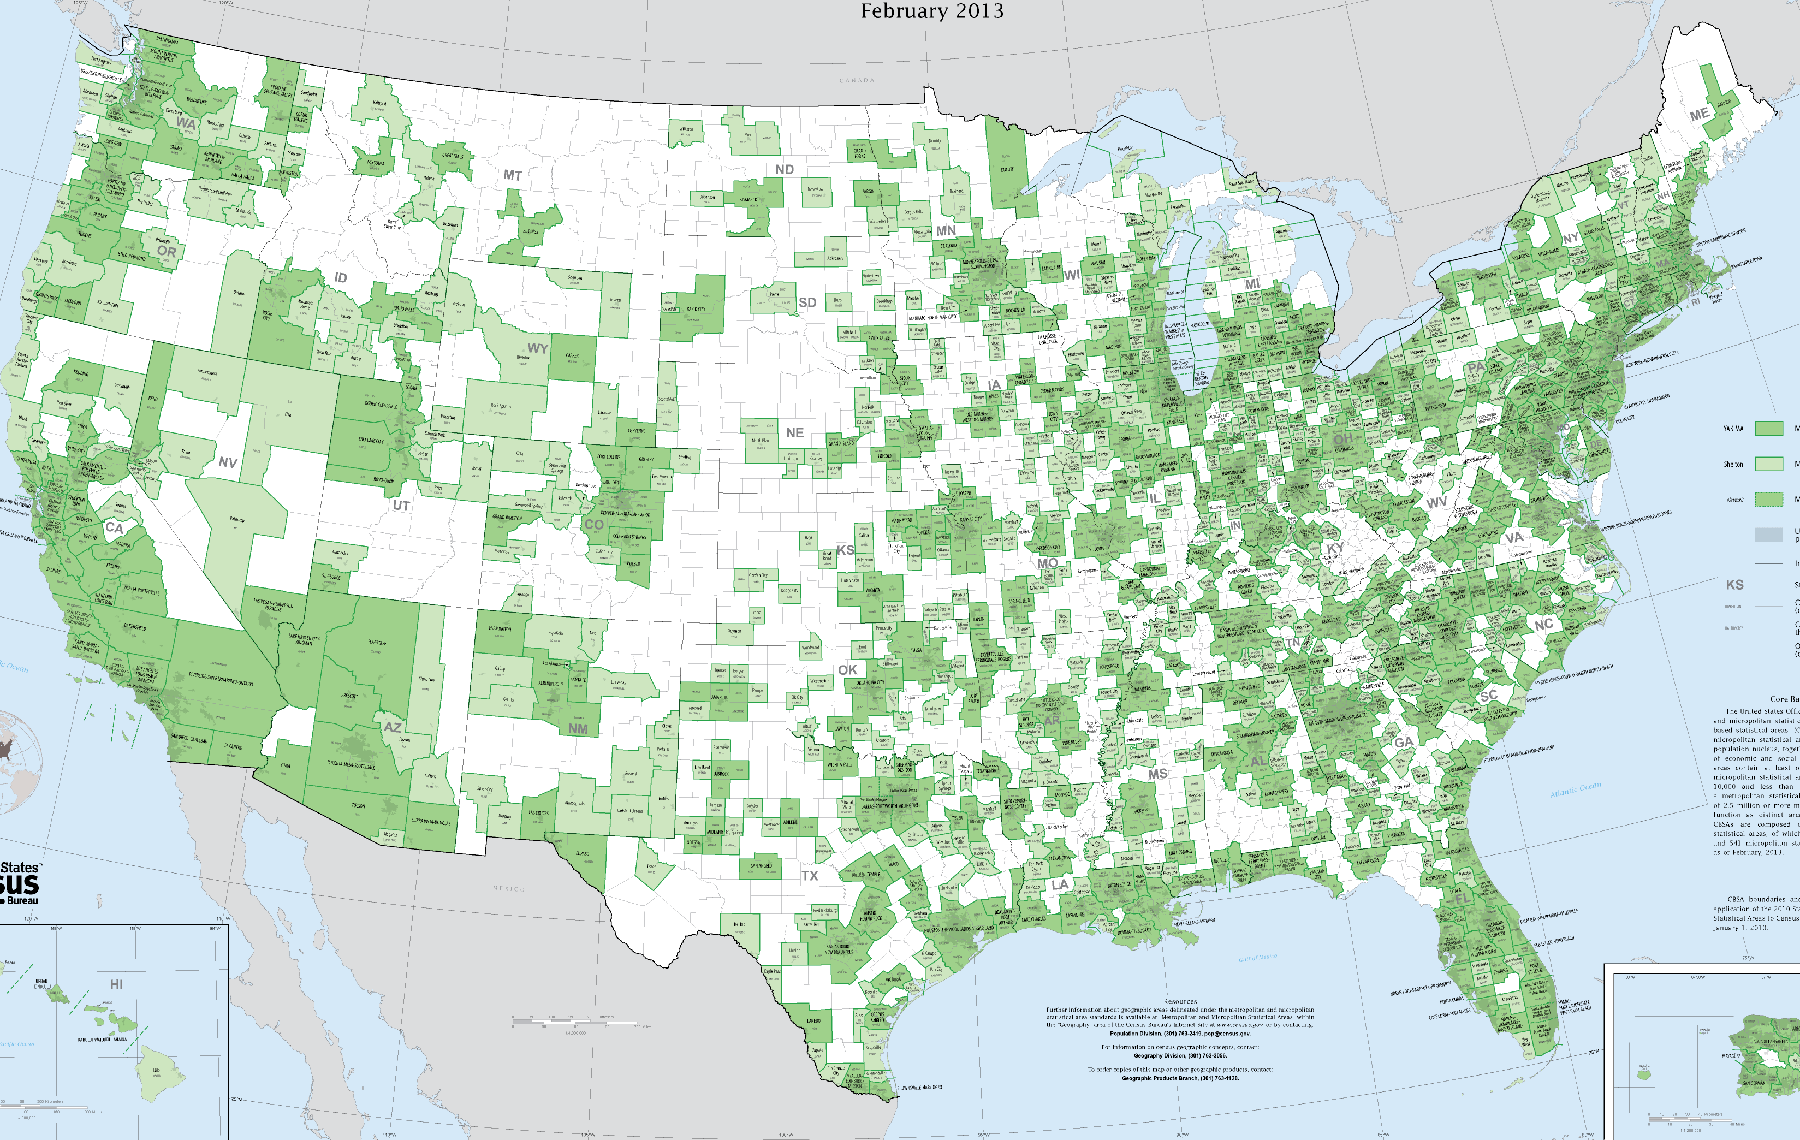
USA Metropolitan and Micropolitan Areas, 2013

Slide 13





CBUS MSA 1983
Added CBUS MSA 1993-2013
CBUS CSA 2013

Slide 14
Background
On the positive side for rural areas is that neoclassical economic theory would predict that local economies converge due to movement of labor and capital.
Convergence was certainly the general case (Barro and Sala-i-Martin, 1991).
So what’s happening….Its actually divergence and places are being left behind.
Notes:
https://www.brookings.edu/wp-content/uploads/1991/01/1991a_bpea_barro_salaimartin_blanchard_hall.pdf

Slide 15
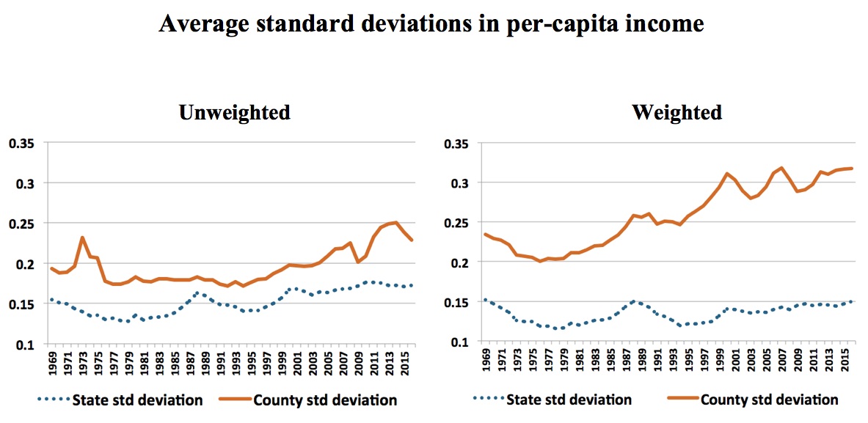
Is basic economic wellbeing diverging?
Unweighted std fall until 1994 to 0.17 before rising almost 50% to 0.25 in 2014.
The population-weighted standard deviations increased from 0.20 in 1976 to about 0.32 in 2016, or a rise of about 60%.
For the unweighted and weighted standard deviations of annual wage and salary job growth, the trend is steady convergence of job growth rates until 2010. After that, there has been about a one-third increase in the unweighted variation between 2010-2016.

Slide 16
Population growth 1990-2017 (%)
1993 USDA and U.S. Census Bureau MSA Definitions

Slide 17
Population growth 2010-2017 (%)
1993 USDA and U.S. Census Bureau MSA Definitions

Slide 18
Has Rural and lagging-region policy been a failure?
1. In many cases yes! Though that’s obvious.
2. It is NOT the case large cities have dominated, though they have a recent advantage. (Mid-size cities lead).
What I argue is that it really depends on when your lagging-region policy began.
  Temporal measurement is critical.
Going back to 1950, nonmetro areas subsequently grew faster than metro areas. Timing is everything.
Yet, as more nonmetro areas were reclassified as metro:
  Through growing above 50,000 to be classified a metro area
  or forming stronger commuting links with an existing one
The remaining nonmetro areas are increasingly the most challenging and over time lag further and further behind.

Slide 19
Rural Development has not been a failure. Though true that it will be more difficult going forward.

Slide 20
Are all rural areas in decline?
Simply, there are three main rural areas:
1. Urban-adjacent rural, which I want to talk about most.
2. High rural amenity ones that are growing faster in the US and Western EU (Rodriguez-Pose and Ketterer, 2012).
3. Remote rural areas that usually were or still are dependent on only extractive/agricultural industries. Usually just one.
  Lack agglomeration economies and amenities. They often look backward to a “glory” era of prosperity rather than forward.
  Outside of major governance changes, perfect policies, entrepreneurship, and amalgamation /consolidation to increase agglomeration, it is really hard to think of way to help these regions, so people-based policies should be used. (Holmes County, Ohio is my exception).
  Should scarce resource be used to help such places and would that even work? My point about triage (Olfert and Natcher, 2014, Olfert et al., 2014)?
  Should “San Antonio” subsidize such places with their scarce resources?
Notes:
Rodriguez-Pose and Ketterer (2012) DO LOCAL AMENITIES AFFECT THE APPEAL OF REGIONS IN EUROPE FOR MIGRANTS? Journal of Regional Science.
Olfert, M. Rose and David Natcher. “Social Capital and Place-Based Policy: Aboriginal Communities in Canada.” University of Saskatewan
Olfert, M. Rose, Mark D. Partridge, Julio Berdegué, Javier Escobal, Benjamin Jara, and Felix Modrego. (2014) “Places for Place-Based Policies” Development Policy Review. 32: 5-32.

Slide 21
Metro and Nonmetro areas in the US
Based on 1990 population and 1993 USDA and U.S. Census Bureau MSA Definitions
For metro adjacency, small is < 1 million, large > 1 million

Slide 22
Population growth (%) 1990-2017 by MSA size
(1993 USDA and U.S. Census Bureau MSA Definitions, 1990 population)
Nonmetro Areas
Metro Areas

Slide 23
Population growth (%) 1990-2017 by city size
(2013 USDA and U.S. Census Bureau MSA Definitions, 2017 Population)
Nonmetro Areas
Metro Areas

Slide 24
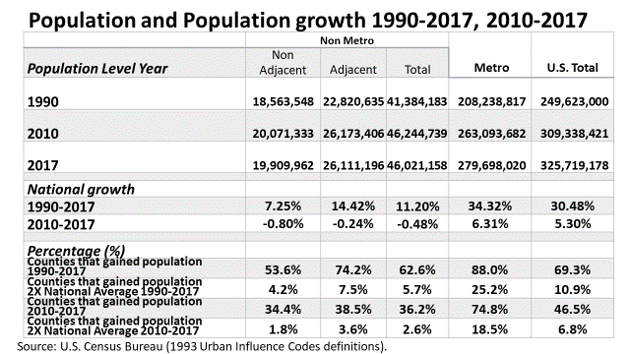

Slide 25
“Rural” is just farming, forestry, and mining
  NO!!!!
  Most areas rural long ago diversified out of agriculture.
  While the landscape may look like farms, the people have organized themselves into a much more diversified economy that is often urban centered.
    e.g., over 360 nonmetro counties are reliant on manufacturing and 426 on recreation/tourism
  However, rural areas have a slow-growing industry composition that is magnified because it is underperforming.

Slide 26
Figure 1
Percentage of Total Jobs in Farming: 1969 - 2015
Source: Farming share of total employment for Metropolitan, Non-Metropolitan, and US : Bureau of Economic Analysis; Total Full-Time and Part-Time Employment CA25 (1969 – 2000) CA25N (2001 – 2015). Farming as primary job as a share of total employment: Bureau of Labor Statistics, Table cpsaat01

Slide 27
Notes:
To illustrate the change in rural America, note that roughly all of Rural America outside of the Northeast and the West Coast was farm dependent in 1950.
That “rural” economy was very influenced by global events such as the boom in commodity prices surrounding WW II and the Korean War.

Slide 28
Notes:
In terms of rural development, it is the green counties that would mostly benefit from expanded farming employment. Other rural counties are much more tied to nearby urban areas in an interdependent relationship.
By 2000, farm dependent counties were mostly limited to the Great Plains. Other remote rural counties that have often struggled include natural resource dependent counties—usually in mining or forestry.
The rapid increases in productivity in farming and natural resources have put these regions at a disadvantage in terms of employment opportunities (e.g., we need fewer farmers to produce the same amount of food as we did in the 1940s). Farm productivity is good for feeding the world, but has put many rural communities under stress.
Another problem is the tremendous changes in rural America have gone mostly unrecognized in key circles. Policies are often designed with the 1950 vision of rural America, not the current much more diverse version.

Slide 29
Same pattern in emerging countries:
Chile Share of employment in Agriculture, Mining, and Manufacturing (1990-2018)
Source: Central Bank of Chile. Note: 2018 considers January till August.

Slide 30
Aside: Commercial Message for Regional Science
  I approve this ad ☺.
Notes:
Rodriguez-Pose and Ketterer (2012) DO LOCAL AMENITIES AFFECT THE APPEAL OF REGIONS IN EUROPE FOR MIGRANTS? Journal of Regional Science.
Olfert, M. Rose and David Natcher. “Social Capital and Place-Based Policy: Aboriginal Communities in Canada.” University of Saskatewan
Olfert, M. Rose, Mark D. Partridge, Julio Berdegué, Javier Escobal, Benjamin Jara, and Felix Modrego. (2014) “Places for Place-Based Policies” Development Policy Review. 32: 5-32.

Slide 31
Aside: Stop Regional JUNK SCIENCE
  We need to be at the forefront of fighting JUNK SCIENCE in our field. Good policy comes from facts, not propaganda.
    CRENET has an award for the most outrageous impact study.
    My nominee is Donald Trump on the impact of Saudi military sales.
  My nominee is from North Carolina State University on an agriculture “fact sheet,” but it could come from any industry. It drew my attention from a Wash Post article.
    Last year I gave numerous example from oil and gas of over-exaggerated predictions of job creation.
  Disappointing it came from a university.
  Basically, NCSU’s extension economists wants us to believe that North Carolina’s level of development is of a developing country with the high agriculture shares one would find there—e.g., double of Chile.
Notes:
Rodriguez-Pose and Ketterer (2012) DO LOCAL AMENITIES AFFECT THE APPEAL OF REGIONS IN EUROPE FOR MIGRANTS? Journal of Regional Science.
Olfert, M. Rose and David Natcher. “Social Capital and Place-Based Policy: Aboriginal Communities in Canada.” University of Saskatewan
Olfert, M. Rose, Mark D. Partridge, Julio Berdegué, Javier Escobal, Benjamin Jara, and Felix Modrego. (2014) “Places for Place-Based Policies” Development Policy Review. 32: 5-32.

Slide 33
Almost 17% is exactly 1/6th and not one-fifth!
in 2016, farm, forestry, fishing, and related industries actually accounted for 1.6% of total NC employment (including proprietors).

Slide 37
Regional JUNK SCIENCE
  Let’s see, if North Carolina banned (real) agriculture, all of its clothing stores, grocery stores, etc. would close down??
  Use manufacturing and education as counter examples for further Reductio ad absurdum. My “silly” examples are actually better.
  Walmart and virtually all retailers are manufacturers because they sell manufactured products.
  Grocery stores (e.g., Kroger) should be manufacturing because they sell products that have been manufactured.
  Government should be included in manufacturing because they use manufactured products as inputs.
  QED, because every sector uses manufactured goods, manufacturing “accounts for 100% of jobs and income in our economy.”
  Or education is 100% of the economy because every industry uses educated workers as an input.
  Human capital has a vastly higher share of VA in the economy than the NC ag example.
Notes:
Rodriguez-Pose and Ketterer (2012) DO LOCAL AMENITIES AFFECT THE APPEAL OF REGIONS IN EUROPE FOR MIGRANTS? Journal of Regional Science.
Olfert, M. Rose and David Natcher. “Social Capital and Place-Based Policy: Aboriginal Communities in Canada.” University of Saskatewan
Olfert, M. Rose, Mark D. Partridge, Julio Berdegué, Javier Escobal, Benjamin Jara, and Felix Modrego. (2014) “Places for Place-Based Policies” Development Policy Review. 32: 5-32.

Slide 38
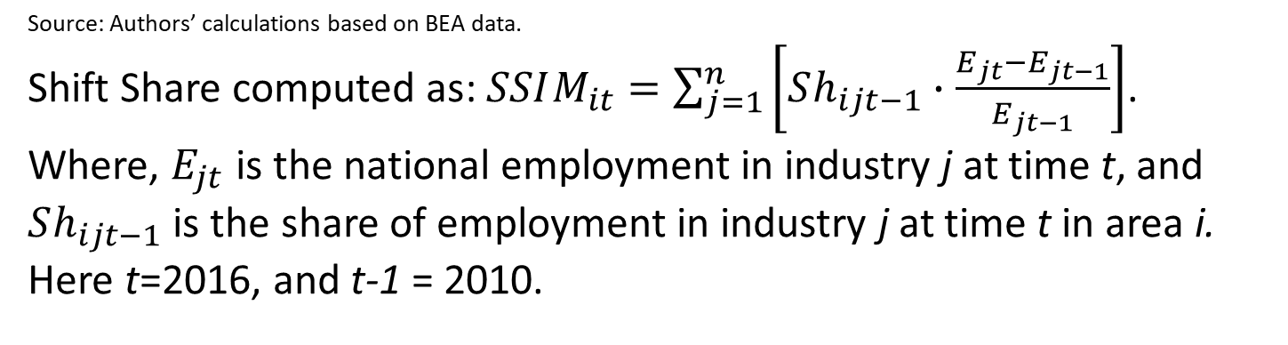
Nonmetro: 0.453 (.0268686) ***
Metro: 0.241 (.0560665) ***
Source: Authors’ calculations based on BEA data.
Shift Share computed as: $SSIM_{it}=\sum_{j=1}^{n}{\left[Sh_{ijt−1}∙\frac{E_{jt}−E_{jt−1}}{E_{jt−1}}\right]}$. Where, $E_{jt}$ is the national employment in industry j at time t, and $Sh_{ijt−1}$ is the share of employment in industry j at time t in area i. Here t=2016, and t-1 = 2010.

Slide 39
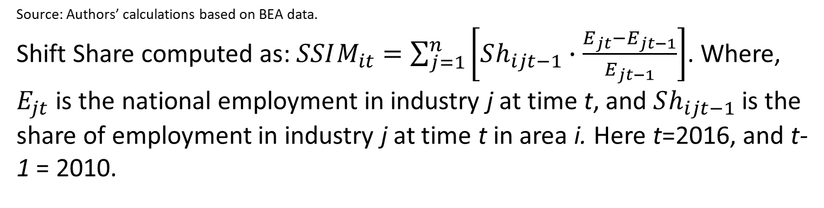
Source: Authors’ calculations based on BEA data.
Shift Share computed as: $SSIM_{it}=\sum_{j=1}^{n}{\left[Sh_{ijt−1}∙\frac{E_{jt}−E_{jt−1}}{E_{jt−1}}\right]}$. Where, $E_{jt}$ is the national employment in industry j at time t, and $Sh_{ijt−1}$ is the share of employment in industry j at time t in area i. Here t=2016, and t-1 = 2010.

Slide 40
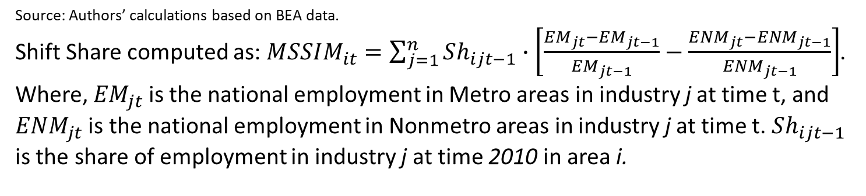
Source: Authors’ calculations based on BEA data.
Shift Share computed as: $MSSIM_{it}=\sum_{j=1}^{n}{Sh_{ijt−1}∙\left[\frac{{EM}_{jt}−{EM}_{jt−1}}{{EM}_{jt−1}}−\frac{{ENM}_{jt}−{ENM}_{jt−1}}{{ENM}_{jt−1}}\right]}$. Where, ${EM}_{jt}$ is the national employment in Metro areas in industry j at time t, and ${ENM}_{jt}$ is the national employment in Nonmetro areas in industry j at time t. $Sh_{ijt−1}$ is the share of employment in industry j at time 2010 in area i.
Source: BEA

Slide 41
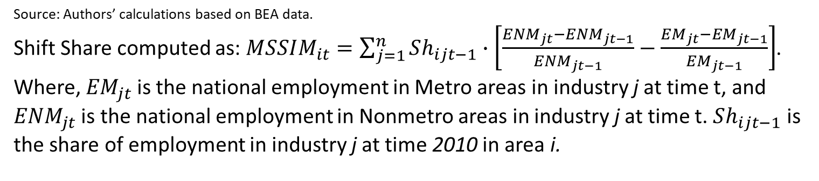
Difference between Nonmetro andMetro counties due to slower growth of Nonmetro Industries
Source: Authors’ calculations based on BEA data.
Shift Share computed as: $MSSIM_{it}=\sum_{j=1}^{n}{Sh_{ijt−1}∙\left[\frac{{ENM}_{jt}−{ENM}_{jt−1}}{{ENM}_{jt−1}}−\frac{{EM}_{jt}−{EM}_{jt−1}}{{EM}_{jt−1}}\right]}$. Where, ${EM}_{jt}$ is the national employment in Metro areas in industry j at time t, and ${ENM}_{jt}$ is the national employment in Nonmetro areas in industry j at time t. $Sh_{ijt−1}$ is the share of employment in industry j at time 2010 in area i.
Source: BEA

Slide 42
What can we do? Urban-led growth
  If you can’t beat them, join them.
  Urban-adjacent rural areas have a great deal of potential because they can rely on urban-led growth and access to or “borrow” agglomeration economies.
  Commuters are a key component to rural community sustainability through providing a critical mass for public services and local businesses.
    Stop the vicious downward cycle.
  But growth is not magical; good policy is needed to ensure this will happen. I will discuss later.

Slide 43
Journal of Economic Geography, 2008

Slide 44
Journal of Economic Geography

Slide 46
Figure 4: Distance Penalties (%) for Housing Costs 2000
Notes:
Distance penalty strongest in West

Slide 47
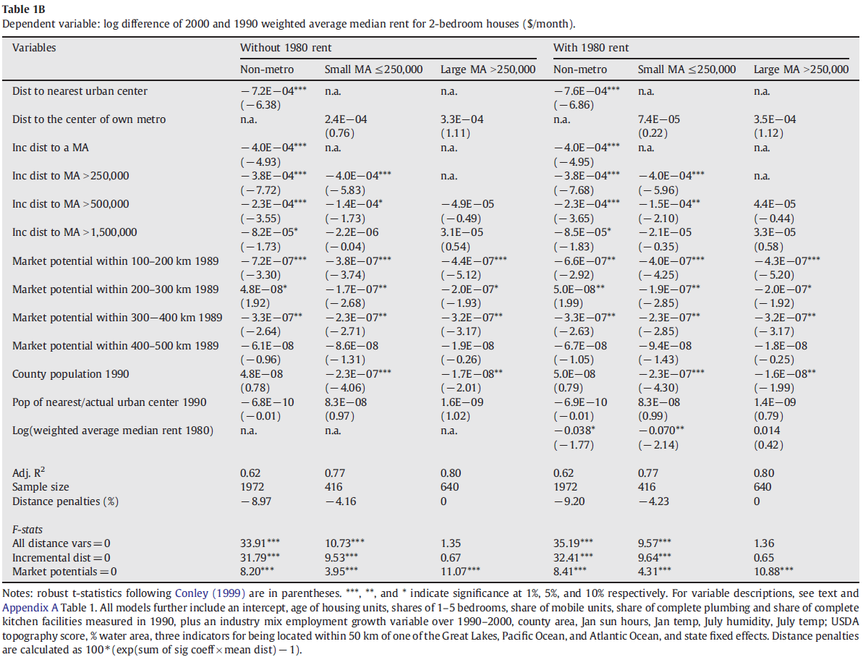

Slide 48
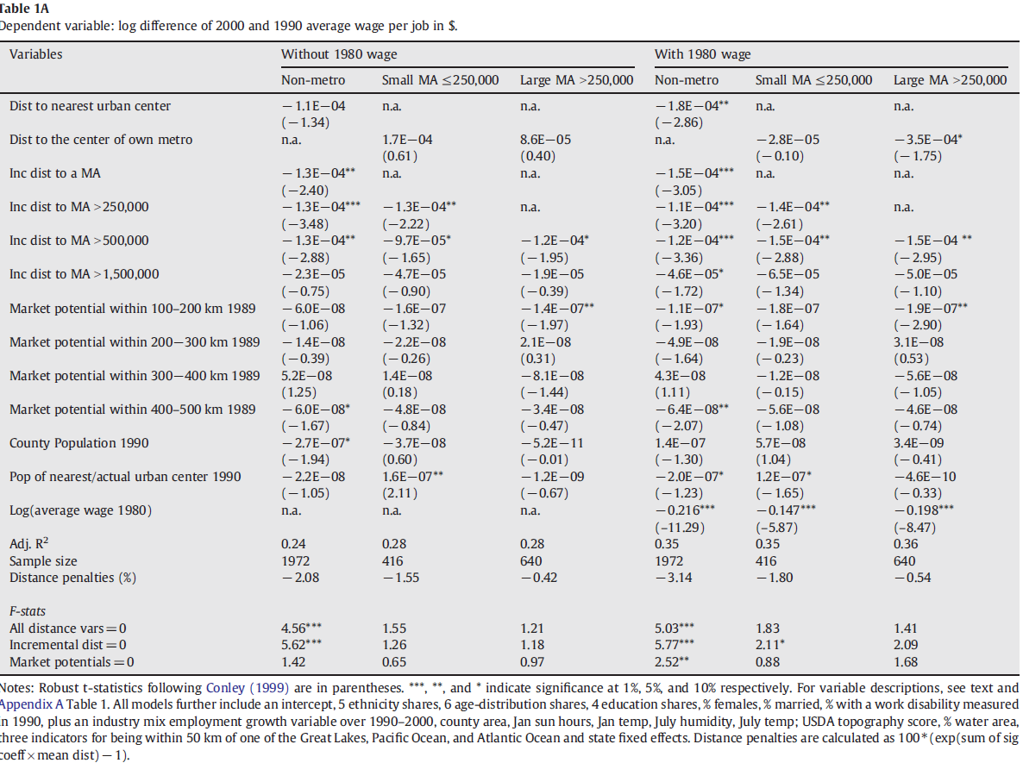

Slide 49
What is good rural or lagging-region policy?
Export-based strategy is naïve. They tend to be high-productivity and losing jobs and, by definition, have a capital account deficit—i.e., capital is leaving the region (Kilkenny & Partridge, 2009), Krugman 2018 NYT.
It should not facilitate sectoral rent seeking in the guise of rural or regional development. For example, agriculture subsidies or coal mining deregulation is not rural development.
Collaborate with partners (including cities); build from within; quality of life; and quit doing “stupid stuff” such as following the latest fad. Carrot and Sticks.
Rural economies have fundamentally changed from a primary sector economy to one based on rural-urban interdependence.
When there are spillovers, economists argue that they should be internalized. Hence, economic development policies should be done across the entire affected region, not in a piecemeal fashion of competing rural and urban self-interests.

Slide 50
What is good rural or lagging-region policy?
  1. Governance reform to shift from separate farm/rural/urban policies to a regional policy.
    Policy goals include: Tax sharing, planning and management of the rural-urban fringe, environmental protection, infrastructure, economic development for regions. This helps facilitate cooperation.
    Key issue is how to get all actors to participate and believe their input is valued. Leverage local social capital and networks to promote good governance (Natcher and Olfert, 2012). If not, mainly sectoral actors will participate to seek rents.

Slide 51
Good Strategies—cont.
2. 21st Century will belong to places that use their knowledge to leverage their assets.
  Rural communities should be attractive to knowledge workers and commuters.
    Quality of life, pleasant environment, sustainable development; good public services such as schools—this is good economics!
    Attract return migrants in the 30s after they have seen bright lights. Young adults will always flee to the cities.
  Rural US counties with greater shares of knowledge workers grow faster than metro areas (even metros with knowledge workers) and they grow about twice the rate of rural counties with low shares (Wojan and McGranahan, 2007).
Notes:
good schools implies skilled workers & attract their parents.
As Ed Glaeser says, get a lot of smart people and get out of there way.

Slide 52
Good Strategies--cont
3. Business retention and expansion is better than tax incentives for outside investment. Building local Entrepreneurship
  Treat all businesses alike (Li et al., 2016).
  If you build a good climate for investment, your own businesses will thrive and STAY!
    SME development is important because small businesses buy locally; profits stay local (Goetz et al.).
    Bigger multipliers (Tsevetkova et al., forthcoming).
      Entrepreneurship is critical and while academics say focus on the “opportunity” start-ups versus “necessity” start-ups, when I talk to actual people on the ground, they point to zillions of necessity start-ups that are vastly successful (Stephens and Partridge, 2011; Stephens et al., 2011.
Notes:
Li, Minghao, Stephan J. Goetz, Mark D. Partridge, and David A. Fleming. (2016) “County Location Determinants of the INC5000s.” Entrepreneurship & Regional Development. 28: 97-125. DOI: 10.1080/08985626.2015.1109003.
Tsvetkova, Alexandra, Mark D. Partridge, and Michael Betz. (forthcoming) "Self-employment effects on regional growth: A bigger bang for a buck?" Small Business Economics Journal.
Small businesses create more jobs on net--Birch.

Slide 53
Conclusions
Cities are the engines of growth and urban-led growth can be an effective rural strategy.
Focus on realities such as emerging regions that the people have self formed—the politicians lag what the people are doing. Regionalism.
Adopt good strategies that don’t require perfect foresight.
  You just need to make it such that the best firms want to be in your community.
Education & entrepreneurship are keys.
Quality of life is critical in attracting the right people including commuters.
Regional scientists need to better defend our turf and call out horrible analysis by those who are masquerading as regional scientists.
Notes:
Places don’t have to figure out the winning firms, but make it so that they will want to be where you are.

Slide 54

Thank you
partridge.27@osu.edu
Google Mark Partridge economist
54
Notes:
To conclude, I want to reaffirm what a pleasure it has been here today. I acknowledge that building a better, more sustainable future can seem challenging. Yet, there are opportunities and regional cooperation is high on that list. For this, I hope this presentation has stimulated you, not only for the remainder of this workshop, but also to go back and to your communities and try new innovative solutions.

Slide 56
Population growth (%) vs Population (logs) in 2010
MSAs, 1993 USDA and U.S. Census Bureau MSA Definitions

Slide 57
Population growth (%) vs Population in 2010
MSAs, 1993 USDA and U.S. Census Bureau MSA Definitions

Slide 58
Population growth 1990-2017 (%)
Nonmetro, non-adjacent areas, 1993 USDA and U.S. Census Bureau MSA Definitions

Slide 59
Population growth 1990-2017 (%)
Nonmetro, adjacent to small metro areas, 1993 USDA and U.S. Census Bureau MSA Definitions

Slide 60
Population growth 1990-2017 (%)
Nonmetro, adjacent to large metro areas, 1993 USDA and U.S. Census Bureau MSA Definitions

Slide 61
Population growth 1990-2017 (%)
Metro areas, Population 50-100 k, 1993 USDA and U.S. Census Bureau MSA Definitions

Slide 62
Population growth 1990-2017 (%)
Metro areas, Population 100-250 k, 1993 USDA and U.S. Census Bureau MSA Definitions

Slide 63
Population growth 1990-2017 (%)
Metro areas, Population 250-1,000 k, 1993 USDA and U.S. Census Bureau MSA Definitions

Slide 64
Population growth 1990-2017 (%)
Metro areas, Population 1-3,000 k, 1993 USDA and U.S. Census Bureau MSA Definitions

Slide 65
Population growth 1990-2017 (%)
Metro areas, Population 3,000 k +, 1993 USDA and U.S. Census Bureau MSA Definitions

Slide 66
Population growth 2010-2017 (%)
Non-metro, non-adjacent areas, 1993 USDA and U.S. Census Bureau MSA Definitions

Slide 67
Population growth 2010-2017 (%)
Non-metro, adjacent to small metro areas, 1993 USDA and U.S. Census Bureau MSA Definitions

Slide 68
Population growth 2010-2017 (%)
Non-metro, adjacent to large metro areas, 1993 USDA and U.S. Census Bureau MSA Definitions

Slide 69
Population growth 2010-2017 (%)
Metro areas, Population 50-100 k, 1993 USDA and U.S. Census Bureau MSA Definitions

Slide 70
Population growth 2010-2017 (%)
Metro areas, Population 100-250 k, 1993 USDA and U.S. Census Bureau MSA Definitions

Slide 71
Population growth 2010-2017 (%)
Metro areas, Population 250-1,000 k, 1993 USDA and U.S. Census Bureau MSA Definitions

Slide 72
Population growth 2010-2017 (%)
Metro areas, Population 1-3,000 k, 1993 USDA and U.S. Census Bureau MSA Definitions

Slide 73
Population growth 2010-2017 (%)
Metro areas, Population 3,000 k +, 1993 USDA and U.S. Census Bureau MSA Definitions

Slide 74
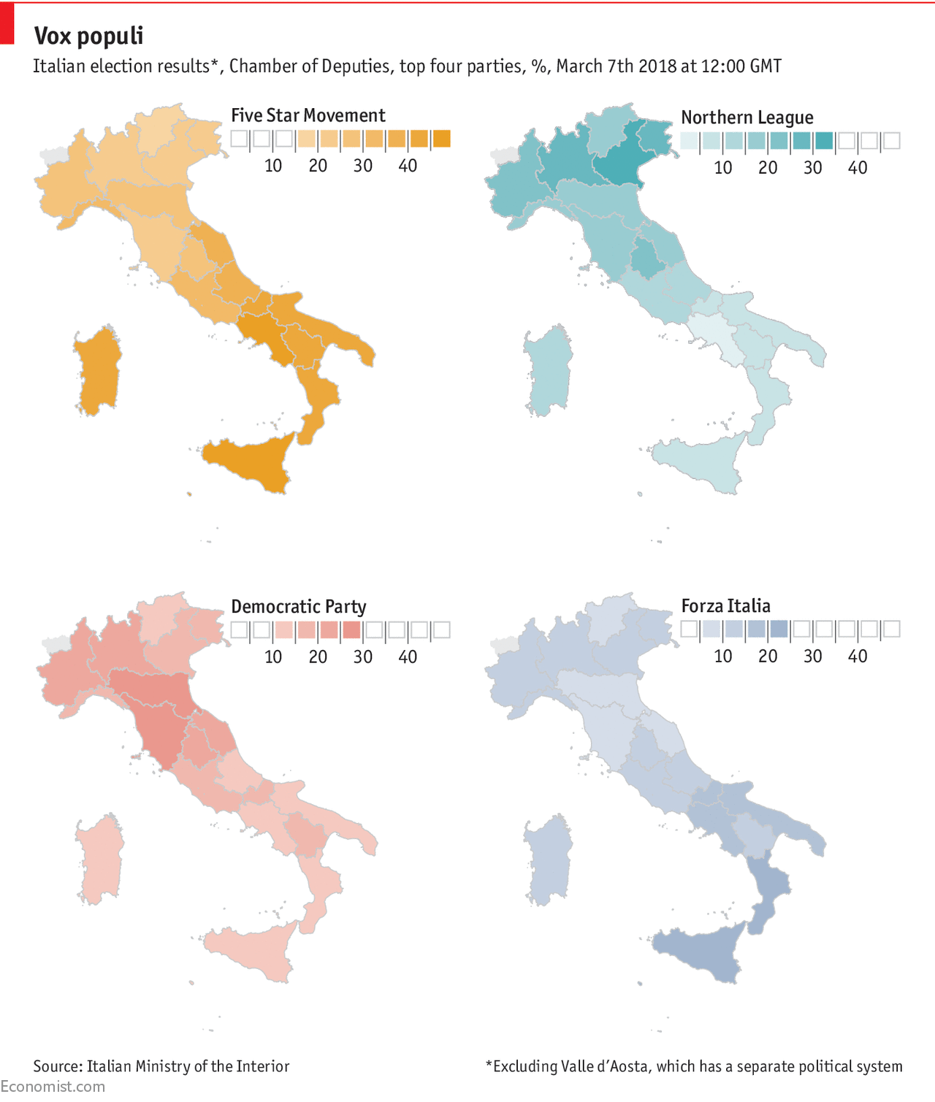

Slide 75
Share of 2017 population in each category
(1993 USDA and U.S. Census Bureau MSA Definitions using 1990 population)
Nonmetro
Metro

Slide 76
Population growth (%) vs Population (logs) in 1990
MSAs, 1993 USDA and U.S. Census Bureau MSA Definitions

Slide 77
Population growth (%) vs Population in 1990
MSAs, 1993 USDA and U.S. Census Bureau MSA Definitions

Slide 78
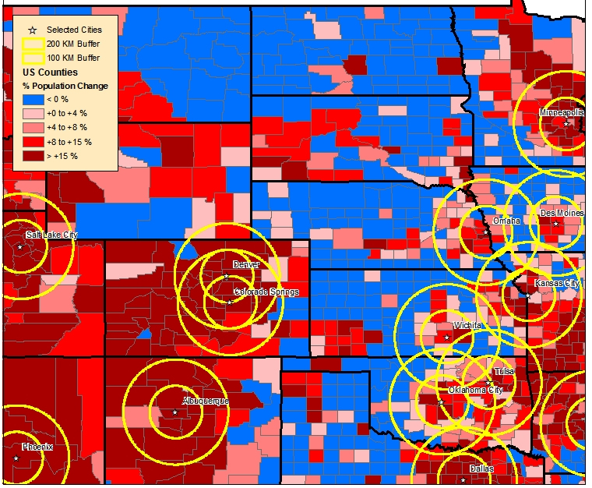
Plains States Engines of Growth
1990-2000 Population Growth
Notes:
Engines of Growth are defined as MAs > 500,000 population, 2003 definition. Population change over the 1990-2000 period using U.S. Census Data.
100km and 200km rings. 100kms is one hour commuting distance.
Great Plains really show the 3 Americas due to its dispersed population settlements. Also the catalyst for much of Congressional discussion on rural policy.
Growth is heavily concentrated in these rings around engines of growth. Growth also occurs in mountains, Black Hills, Ozarks—High Amenity growth!
Some “small” engines of growth are Fargo-Moorhead, Bismarck, Sioux Falls/Sioux City, and the I80 corridor across Nebraska.

